Slide 1
CS305
System Modeling and Simulation
Prof. Dr. Khaled Mahar
khmahar@aast.edu
Lecture 4

Slide 2
Chapter 5 Statistical Models in Simulation
Banks, Carson, Nelson & Nicol
Discrete-Event System Simulation

Slide 3
Poisson Process
Process N(t)
random variable N that depends on time t with a common state space S.
Poisson Process: a Process that has a Poisson Distribution
N(t) is called a counting Poisson process
There are two types:
Homogenous Poisson Process: constant average rate
Non-Homogenous Poissoon Process: variable average rate

Slide 4


What is “Stochastic Process”?
State Space = {SUNNY,
RAINNY}
Day
Day 1
Day 2
Day 3
Day 4
Day 5
Day 6
Day 7
THU
FRI
SAT
SUN
MON
TUE
WED
X(day_{i}): Status of the weather observed each DAY

Slide 5
Examples of using Poisson Process
The number of web page requests arriving at a server may be characterized by a Poisson process except for unusual circumstances such as coordinated denial of service attacks.
The number of telephone calls arriving at a switchboard, or at an automatic phone-switching system, may be characterized by a Poisson process.
The arrival of "customers" is commonly modelled as a Poisson process in the study of simple queueing systems.
The execution of trades on a stock exchange, as viewed on a tick by tick basis, is a Poisson process.

Slide 6
(Homogenous) Poisson Process
Formally, a counting process is a (homogenous) Poisson process with constant average rate λ if:
describes the number of events in time interval
The mean and the variance are equal
t
t+τ
t+τ+θ

Slide 7
Splitting and Pooling [Poisson Dist’n]
Splitting:
Suppose each event of a Poisson process can be classified as Type I, with probability p and Type II, with probability 1-p.
N(t) = N1(t) + N2(t), where N1(t) and N2(t) are both Poisson processes with rates λ p and λ (1-p)
Pooling:
Suppose two Poisson processes are pooled together
N1(t) + N2(t) = N(t), where N(t) is a Poisson processes with rates λ₁ + λ₂
λp
N1(t) ~ Poi[λp]
N(t) ~ Poi(λ)
λ
λ(1-p)
N2(t) ~ Poi[λ(1-p)]
N1(t) ~ Poi[λ₁]
λ₁
λ₁ + λ₂
N(t) ~ Poi(λ₁ + λ₂)
N2(t) ~ Poi[λ₂]
λ₂

Slide 8
Non Homogenous (non-stationary) Poisson Process (NSPP)
The non homogeneous Poisson process is characterized by a VARIABLE rate parameter λ(t), the arrival rate at time t. In general, the rate parameter may change over time.
The expected number of events (e.g. arrival) between time s and time t is
λ1
λ2
λ3

Slide 9
Example: Non-stationary Poisson Process (NSPP)
The number of cars that cross the intersection of two roads is distributed according to a non homogenous Poisson process with a mean λ(t) defined as follows:
Let us consider the time 8 am as t=0.
Q1. Compute the average arrival number of cars at 11:30?
Q2. Determine the equation that gives the probability of having only 10000 car arrivals between 12 pm and 16 pm.
Q3. What is the distribution and the average (in seconds) of the inter-arrival time of two cars between 8 am and 9 am?

Slide 10
Example: Non-stationary Poisson Process (NSPP)
Q1. Compute the average arrival number of cars at 11:30?
Q2. Determine the equation that gives the probability of having only 10000 car arrivals between 12 pm and 16 pm.
We know that the number of cars between 12 pm and 16 pm, i.e. follows a Poisson distribution. During 12 pm and 16pm, the average number of cars is
Thus,
Q3. What is the distribution and the average (in seconds) of the inter-arrival time of two cars between 8 am and 9 am? (Homework)

Slide 11
Non-stationary Poisson Process (NSPP) [Poisson Dist’n]
Example: Suppose arrivals to a Post Office have rates 2 per minute from 8 am until 12 pm, and then 0.5 per minute until 4 pm. What is the probability distribution of the number of arrivals between 11 am and 2 pm?
Let t = 0 correspond to 8 am, NSPP N(t) has rate function:
Expected number of arrivals by time t:
Hence,.
P[N(6) – N(3) = k] = P[N(Λ(6)) – N(Λ(3)) = k]
= P[N(9) – N(6) = k]
= e-⁽⁹⁻⁶⁾(9-6)^{k}/k! = e-³(3)^{k}/k!

Slide 12
Continuous Distributions
Continuous random variables can be used to describe random phenomena in which the variable can take on any value in some interval.
In this section, the distributions studied are:
Uniform
Exponential
Normal
Weibull
Lognormal

Slide 13
Discrete versus Continuous Random Variables
Discrete Random Variable
Continuous Random Variable
Finite Sample Space
e.g. {0, 1, 2, 3}
Infinite Sample Space
e.g. [0,1], [2.1, 5.3]
Probability Mass Function (PMF)
Probability Density Function (PDF)
Cumulative Distribution Function (CDF)

Slide 14
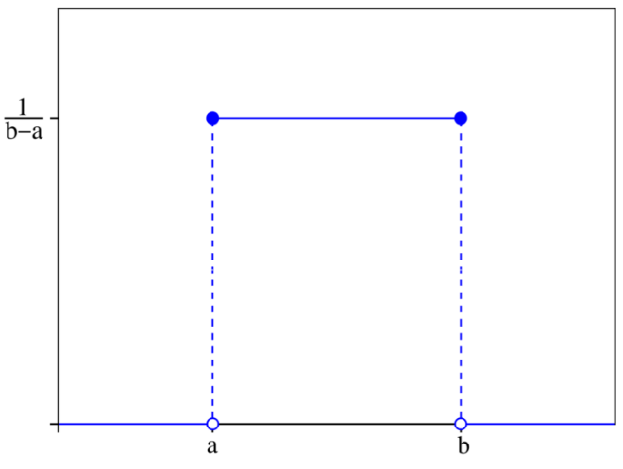
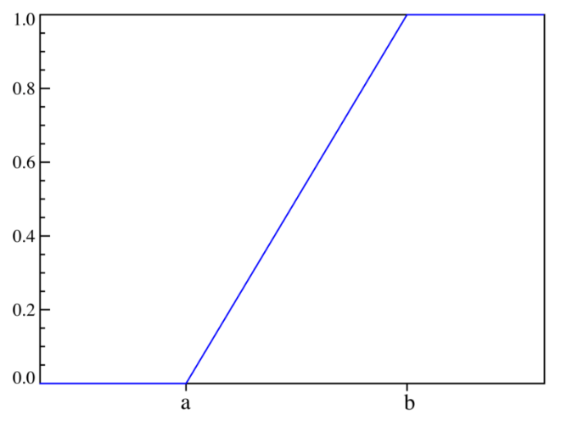
Uniform Distribution [Continuous Dist’n]
A random variable X is uniformly distributed on the interval (a,b), U(a,b), if its pdf and cdf are:
Properties
P(x₁ < X < x₂) is proportional to the length of the interval
[F(x₂) – F(x₁) = (x₂-x₁)/(b-a)]
E(X) = (a+b)/2 V(X) = (b-a)²/12
U(0,1) provides the means to generate random numbers, from which random variates can be generated.
PDF
CDF
Notes:
A uniform random variable is commonly employed in the absence of information on the underlying distribution being modeled.

Slide 15
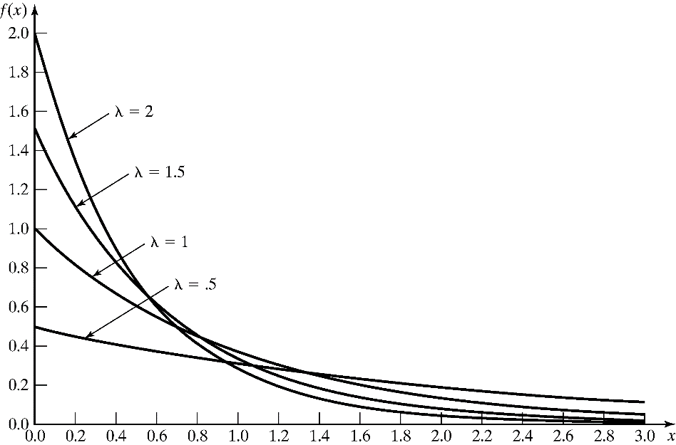
Exponential Distribution [Continuous Dist’n]
A random variable X is exponentially distributed with parameter λ > 0 if its pdf and cdf are:
E(X) = 1/λ V(X) = 1/λ2
Used to model inter-arrival times when arrivals are completely random, and to model service times that are highly variable
Used to model time to failure.
For several different exponential pdf’s (see figure), the value of intercept on the vertical axis is λ.
μ=1/λ
μ:time
λ: rate
Notes:
μ=1/λ, e.g. μ is inter-arrival time while λ is arrival rate.

Slide 16
Exponential Distribution [Continuous Dist’n]
Memoryless property
For all s and t greater or equal to 0:
P(X > s+t | X > s) = P(X > t)
Example: A device failure~ exp(λ = 1/3 per year), hence, the mean lifetime is 3 years.
The probability that the lamp lasts longer than its mean life is:
P(X > 3) = 1-(1-e^{-3/3}) = e⁻¹ = 0.368
The probability that the lamp lasts between 2 to 3 years is:
P(2 <= X <= 3) = F(3) – F(2) = 0.145
The probability that it lasts for another year given it is operating for 2.5 hours:
P(X > 3.5 | X > 2.5) = P(X > 1) = e^{-1/3} = 0.717

Slide 17
Example: Exponential Distribution
The time needed to repair the engine of a car is exponentially distributed with a mean time equal to 3 hours.
The probability that the car spends more than 3 hours in reparation
The probability that the car repair time lasts between 2 to 3 hours is:
The probability that the repair time lasts for another hour given it has been operating for 2.5 hours:
Using the memoryless property of the exponential distribution, we have:

Slide 18
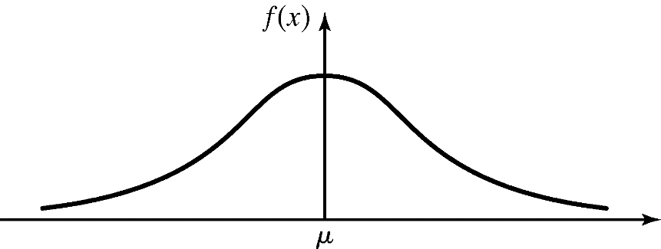
Normal Distribution [Continuous Dist’n]
A random variable X is normally distributed if it has the pdf:
Mean:
Variance:
Denoted as X ~ N(μ,σ²)
Special properties:
f(μ-x)=f(μ+x); the pdf is symmetric about μ.
The maximum value of the pdf occurs at x = μ; the mean and mode are equal.

Slide 19
Normal Distribution [Continuous Dist’n]
The importance of the normal distribution as a model of quantitative phenomena in the natural and behavioral sciences is due in part to the Central Limit Theorem.
It is usually used to model system error (e.g. channel error), the distribution of natural phenomena, height, weight, etc.

Slide 20
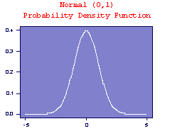
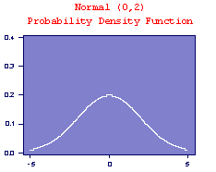
Normal Distribution [Continuous Dist’n]
Example
The simplest case of the normal distribution, known as the Standard Normal Distribution, has expected value zero and variance one. This is written as N(0,1).

Slide 21
Normal Distribution [Continuous Dist’n]
Evaluating the distribution:
Use numerical methods (no closed form)
Independent of μ and σ, using the standard normal distribution:
Z ~ N(0,1)
Transformation of variables: let Z = (X - μ) / σ,

Slide 22
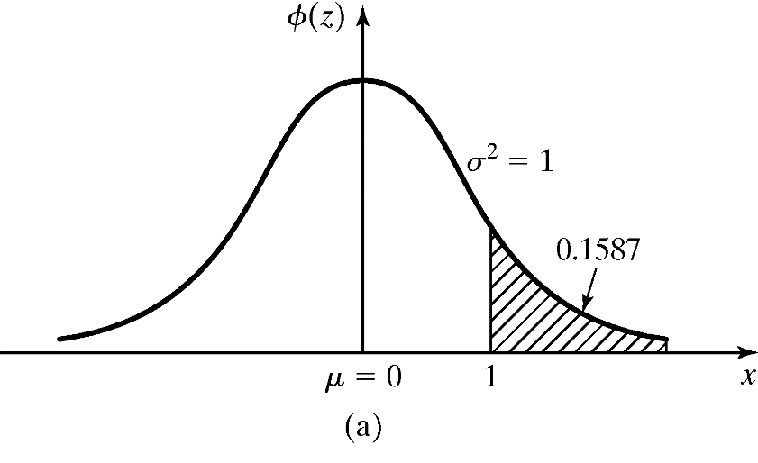
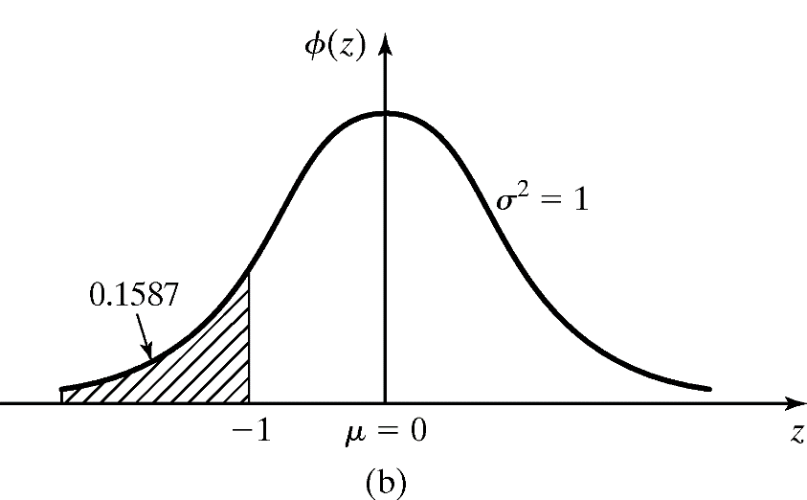
Normal Distribution [Continuous Dist’n]
Example: The time required to load an oceangoing vessel, X, is distributed as N(12,4)
The probability that the vessel is loaded in less than 10 hours:
Using the symmetry property, Φ(1) is the complement of Φ (-1)

Slide 23
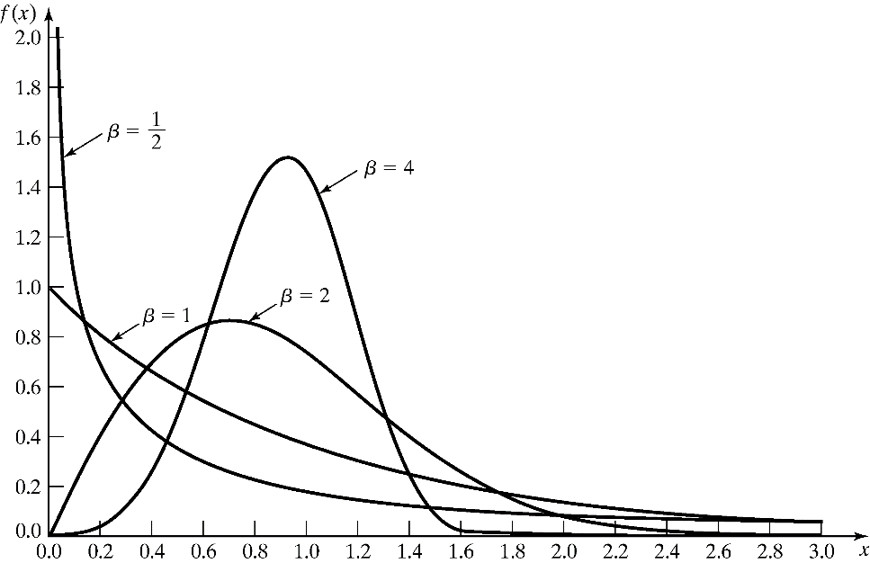
Weibull Distribution [Continuous Dist’n]
A random variable X has a Weibull distribution if its pdf has the form:
3 parameters:
Location parameter: υ,
Shape parameter: β , (β > 0)
Scale parameter. α, (> 0)
Example: υ = 0 and α = 1:
When β = 1,
X ~ exp(λ = 1/α)
Notes:
the Weibull distribution is widely used in reliability and life data analysis.
Λοχατιον παραμετερ ν μεανσ τηατ τηε δεϖιχε ηασ α λιφετιμε ατ λεαστ ϖ.
Weibull distributions with β< 1 have a failure rate that decreases with time, also known early-life failures.
Weibull distributions with β close to or equal to 1 have a fairly constant failure rate, indicative of useful life or random failures.
Weibull distributions with β > 1 have a failure rate that increases with time, also known as wear-out failures.

Slide 24
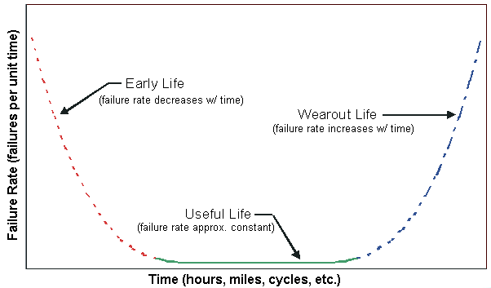
Weibull Distribution [Continuous Dist’n]
A mixed Weibull distribution with one subpopulation with β < 1, one subpopulation with β = 1 and one subpopulation with β > 1 would have a failure rate plot that was identical to the bathtub curve. An example of a bathtub curve is shown in the following chart.

Slide 25
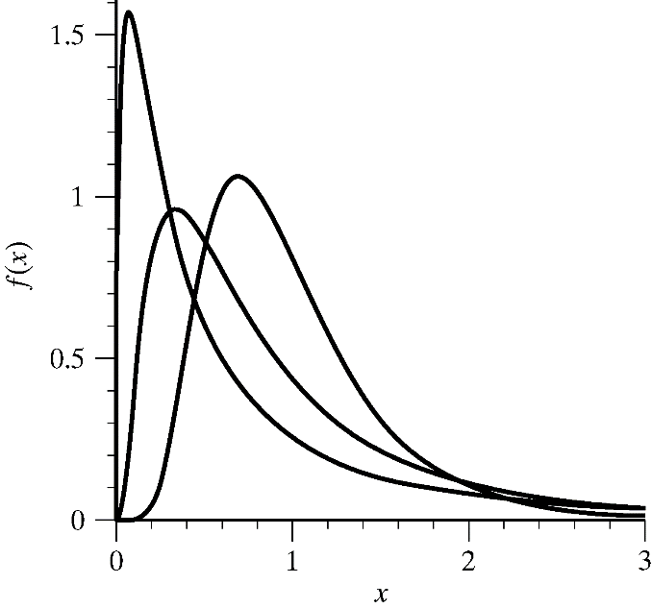
Lognormal Distribution [Continuous Dist’n]
A random variable X has a lognormal distribution if its pdf has the form:
Mean E(X) = e^{μ+σ2/2}
Variance V(X) = e^{2μ+σ2/2 (}e^{σ2} - 1)
Relationship with normal distribution
When Y ~ N(μ, σ²), then X = e^{Y} ~ lognormal(μ, σ²)
Parameters μ and σ² are not the mean and variance of the lognormal
μ=1, σ2=0.5,1,2.
Notes:
A lognormal distribution is a continuous probability distribution of a random variable whose logarithm is normally distributed. Thus, if the random variable X is lognormally distributed, then log(X) has a normal distribution
As shown in the preceding plots, the lognormal PDF and failure rate shapes are flexible enough to make the lognormal a very useful empirical model. In addition, the relationship to the normal (just take natural logarithms of all the data and time points and you have "normal" data) makes it easy to work with mathematically, with many good software analysis programs available to treat normal data.

Slide 26
Empirical Distributions
A distribution whose parameters are the observed values in a sample of data.
May be used when it is impossible or unnecessary to establish that a random variable has any particular parametric distribution.
Advantage: no assumption beyond the observed values in the sample.
Disadvantage: sample might not cover the entire range of possible values.

Slide 27
Summary
The world that the simulation analyst sees is probabilistic, not deterministic.
In this chapter:
Reviewed several important probability distributions.
Showed applications of the probability distributions in a simulation context.
Important task in simulation modeling is the collection and analysis of input data, e.g., hypothesize a distributional form for the input data. Reader should know:
Difference between discrete, continuous, and empirical distributions.
Poisson process and its properties.

